Slide 1
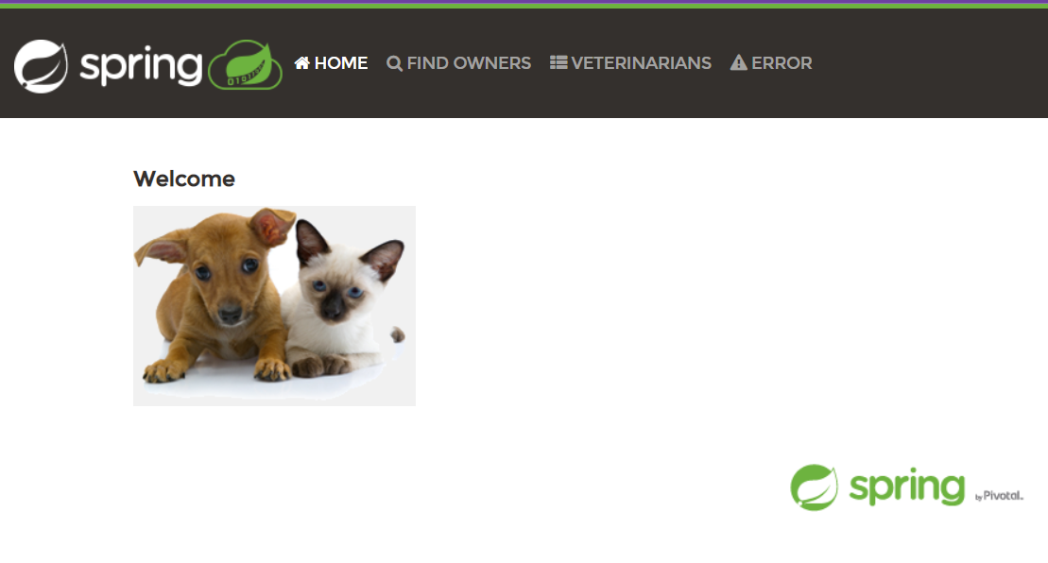
CI&CD PROCESS REALISATION
BASED ON THE PETCLINIC APP

Slide 2

SELF-PRESENTATION SLIDE
NAME: KRASILIA VERONIKA
EDUCATION: BACHELOR’S DEGREE IN ENGLISH LANGUAGE AND LITERATURE
UNIVERSITY: NATIONAL UNIVERSITY OF PEDAGOGY
WORK EXPERIENCE: 2 YEARS OF TEACHING ENGLISH IN ONLINE-SCHOOL “JUSTSCHOOL”

Slide 3




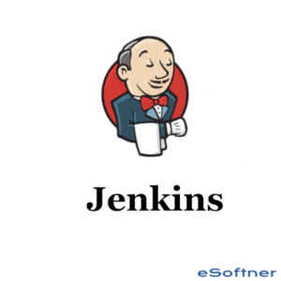
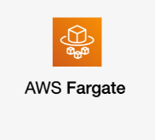

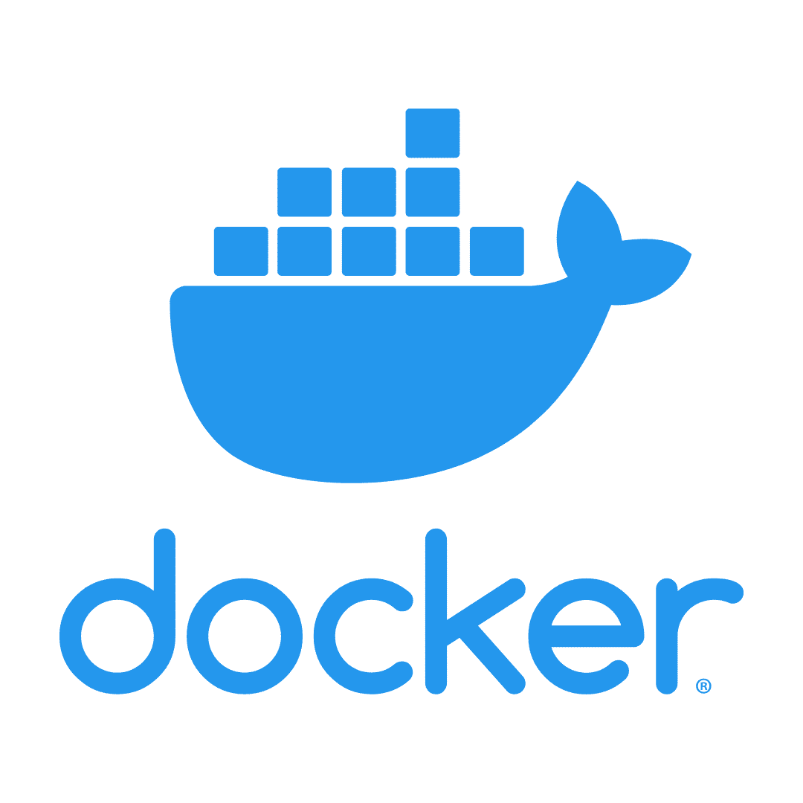
INSTRUMENTS

Slide 4

GOALS
Continuous CODE DELIVERY
FACILITATION OF THE features ADDING
SAVING of CUSTOMER’s MONEY

Slide 5
SOLUTION
Jenkins pipelines
BUILD IN DOCKER CONTAINER
Ecs CLUSTER
+FARGATE TASKS

Slide 6
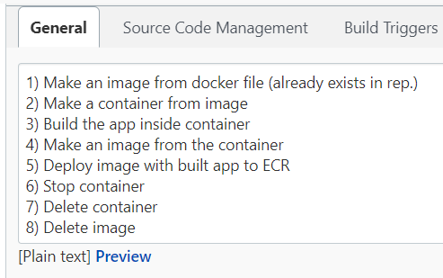
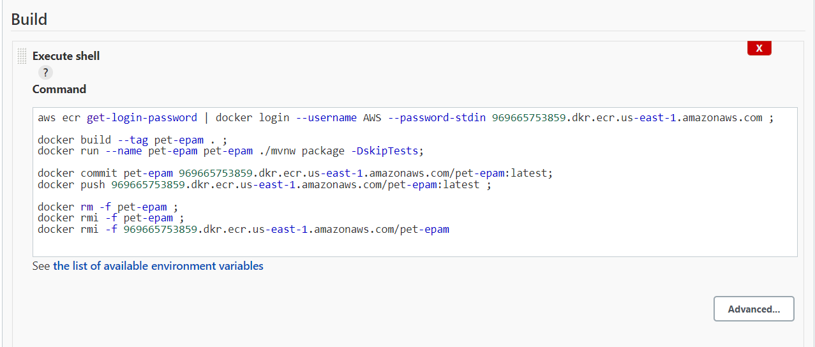
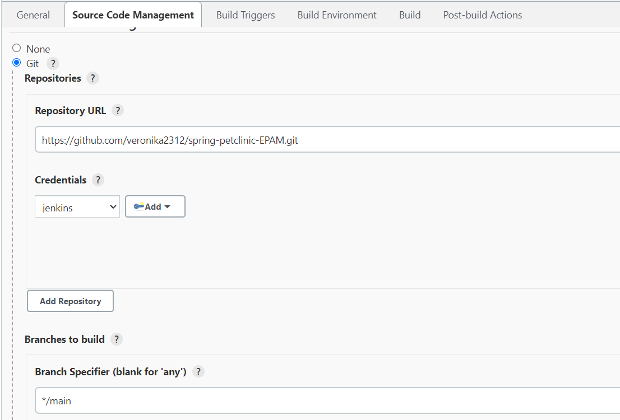
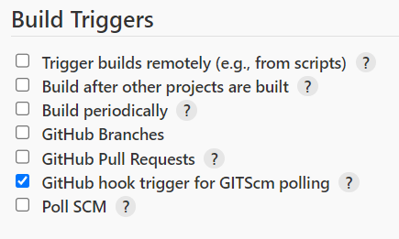
Jenkins
DEFINITION OF THE BUILD GOALS
BUILD PIPELINE
DEFINITION OF THE BUILD SOURCE
BUILD PIPELINE
#login to AWS using JENKINS credentials
aws ecr get-login-password | docker login --username AWS --password-stdin 969665753859.dkr.ecr.us-east-1.amazonaws.com ;
#building image in the current folder
docker build --tag pet-epam . ;
#building container from the image and building the app in it
docker run --name pet-epam pet-epam ./mvnw package -DskipTests;
#building image from the container with built app
docker commit pet-epam 969665753859.dkr.ecr.us-east-1.amazonaws.com/pet-epam:latest;
#push to the ECR repository
docker push 969665753859.dkr.ecr.us-east-1.amazonaws.com/pet-epam:latest ;
#removing images and containers that are useless
docker rm -f pet-epam ;
docker rmi -f pet-epam ;
docker rmi -f 969665753859.dkr.ecr.us-east-1.amazonaws.com/pet-epam
DEFINITION OF THE BUILD TRIGGERS

Slide 7
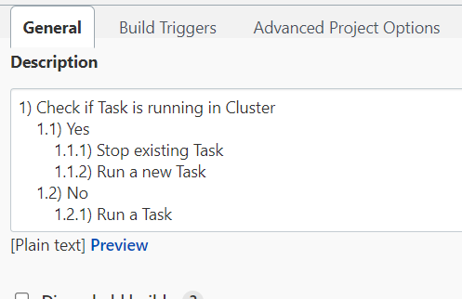
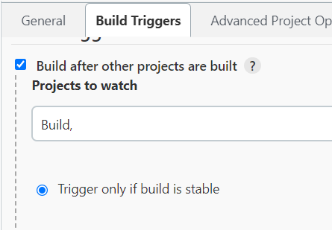
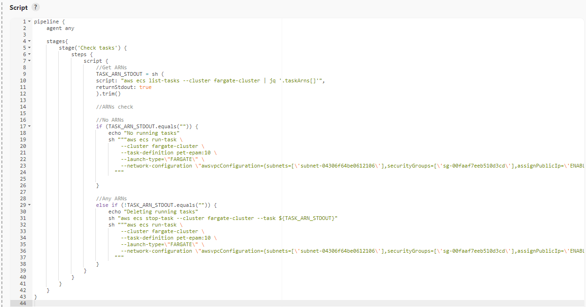
Jenkins
DEFINITION OF THE BUILD GOALS
DEFINITION OF THE BUILD TRIGGERS
BUILD PIPELINE
DEPLOY PIPELINE

Slide 8
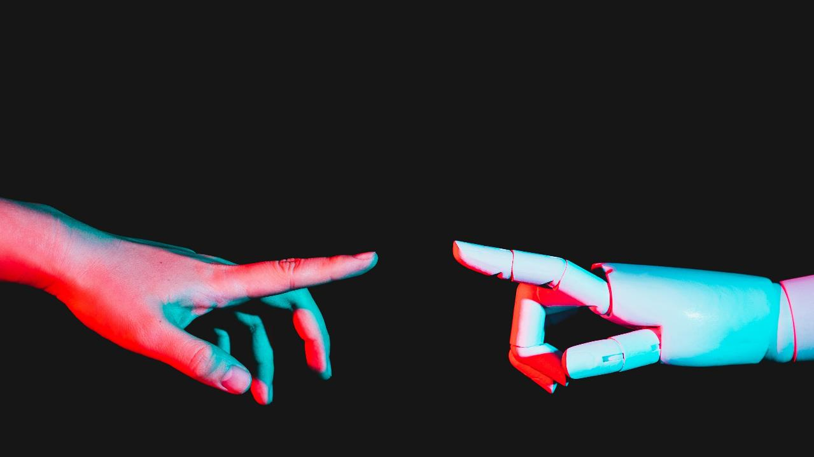
dEMONSTRATION

Slide 9

FUTURE UPGRADES - DEVELOPMENT ENVIROMENT -ADD TESTS

Slide 10

Thanks for your attention!
Veronika Krasilia
+38 (093)-133-69-72
vkrasilia@gmail.com

